Slide 1
Management of Software engineering
Chapter-6

Slide 2
Responsibilities of a Project Manager
1) Planning
In order for a project to be successful and completed within a specified time the project manager for a software company must plan effectively. This also includes:
Scope: The project manager must clearly define the scope of the project and answer questions like, who is the customer? What need will the software satisfy? How will it be beneficial to others? What are the operational requirements for the project?

Slide 3
Activity Schedules: Making activity schedules and planning out the activities according o the time frame is extremely important. He must first list out the jobs to be done and then allot specific jobs to team members. For each job there are different tasks to be accomplished which must be clearly outlined. Identifying and specifying the critical activities of the project and then equally delegating the roles to each member of the team.

Slide 4
Gantt Chart: Once the activities and their different tasks have been outlined, he must list all the activities in a Gantt chart and allot time frames for their completion. This always helps in deciding deadlines for the various activities and also in refining the project plan as it moves along.

Slide 5
Potential Risks: He must plan for any hindrances that might occur during the course of the project. Risk management is an integral part of the project and ensures the presence of a backup plan. Some of the potential risks could be:
Design variations
Variations by the client
Occurrence of dispute and fixing any discrepancies arising due to personal conflicts between the team members.
Incomplete or inaccurate cost estimate
He must be the one to take the decision of handling any free riders in the team and decide on how they are to be handled.
If the project has been delayed then he must try to fix the gap brought about by the delay.

Slide 6
2. Setting Goals
He must set measurable goals that should define the overall project’s objective. For example: Complete the project within six months from start date in the budget of xxx amount. It is concise, crisp and outlines the objective clearly.

Slide 7
3.Time Management
Time estimation for the various activities is of major significance as it helps set the daily priorities of each team member. A project manager has to properly time all the activities for the completion of the project and also prepare for any delays in any of the activities.

Slide 8
4. Budget Allocation and Cost Estimates
Project manager must assign budgets to the various activities and make any cost considerations that there might be.

Slide 9
5. Implementation and Monitoring
Implementation of the project’s activities includes delegating different activities and ensuring their completion on time. Executing the plan of action and ensuring that it is monitored along the way is a key responsibility if his. A project manager must set out the project boundaries and scope for the project which them formulates itself into a plan of action and assists in successful completion of the project.

Slide 10
Skills necessary for software project Managers:
1. Communication
Did you know that 90 percent of a project manager’s time is spent communicating? It’s essential that project managers can effectively convey vision, ideas, goals, and issues—as well as produce reports and presentations, among other skills.

Slide 11
2. Leadership
Leadership is the current buzzword in the project management industry, and with good reason: If you can lead, you can deliver. But most importantly, leadership is often what is missing in the project manager’s arsenal of highly developed technical skills. If you’re a project manager, I can guarantee you have felt the need to improve yourself as a leader at some point.

Slide 12
3. Team management
Besides leading a team from a strategic perspective, project managers also need to manage from an operational point of view. An effective team manager excels at administering and coordinating groups of individuals by promoting teamwork, delegating tasks, resolving conflict, setting goals, and evaluating performance. Leadership is about inspiring others to walk with you; team management makes sure your team has the right shoes.

Slide 13
4. Negotiation
Going back to the communication skill—a lot of this communication has to do with negotiating the use of resources, budgets, schedules, scope creep, and a variety of other compromises that are unavoidable. Knowing how to negotiate well so that all parties are satisfied is a key skill for the successful project manager.

Slide 14
5. Personal organization
Have you ever heard that you cannot give what you do not have? How can you get things done and organize work for other people if your own personal life and projects are disorganized and going nowhere? Get organized personally, and you will immediately improve as a project manager.

Slide 15
6. Risk management
During my “Project Management for You” podcast series, I interviewed top-notch project managers and asked them about their go-to project management tool or technique. I was surprised to see them suggesting risk management. They are absolutely right: If you can predict and create solutions to issues before they arise, you increase your chances of delivering projects successfully. Risks by definition are not urgent; as a result, many project managers fail to consider risks as seriously as they should.

Slide 16
Software Project Management Plan (SPMP)
It begins with a cover page that contains the version control and release information. Each section has a description of the information contained within.

Slide 17
Software Project Management Plan
for
<Name of Project>
<author>
<date>
Version Release Responsible Party Major Changes Date
0.1 Initial Document Release for Comment

Slide 18
Table of Contents
Build the table of contents here. Insert it when you finish your document.
1. Introduction
This section of the SPMP provides an overview of the project.
1.1 Project Overview
Include a concise summary of the project objectives, major work activities, major milestones, required resources, and budget. Describe the relationship of this project to other projects, if appropriate. Provide a reference to the official statement of product requirements.

Slide 19
1.2 Project Deliverables
List the primary deliverables for the customer, the delivery dates, delivery locations, and quantities required satisfying the terms of the project agreement.
1.3 Evolution of the SPMP
Describe how this plan will be completed, disseminated, and put under change control. Describe how both scheduled and unscheduled updates will be handled.

Slide 20
1.4 Reference Materials
Provide a complete list of all documents and other sources of information referenced in the plan. Include for each the title, report number, date, author, and publishing organization.
1.5 Definitions and Acronyms
Define or provide references to the definition of all terms and acronyms required to properlyinterpret the SPMP.

Slide 21
2. Project Organization
This section specifies the process model for the project and its organizational structure.
2.1 Process Model
The process model must include roles, activities, entry criteria and exit criteria for project initiation, product development, product release, and project termination.

Slide 22
2.2 Organizational Structure
Describe the internal management structure of the project, as well as how the project relates to the rest of the organization.
Figure F-2: Organization Chart
2.3 Organizational Interfaces
Describe the administrative and managerial interfaces between the project and the primary entities with which it interacts. A table may be a useful way to represent this information.
Table F-1. Project Interfaces

Slide 23
2.4 Project Responsibilities
Identify and state the nature of each major project function and activity, and identify the individuals who are responsible for those functions and activities. Tables of functions and activities may be used to depict project responsibilities.
Table F-2. Project Responsibilities.

Slide 24
3. Managerial Process
This section of the SPMP specifies the management process for this project.
3.1 Management Objectives and Priorities
3.2 Assumptions, Dependencies, and Constraints
3.3 Risk Management
Describe the process to be used to identify, analyze, and manage the risk factors associated with the project.
3.4 Monitoring and Controlling Mechanisms
3.5 Staffing Approach.

Slide 25
4. Technical Process
This section specifies the technical methods, tools, and techniques to be used on the project. It also includes identification of the work products and reviews to be held and the plans for the support group activities in user documentation, training, software quality assurance, and configuration management.
4.1 Methods, Tools, and Techniques
4.2 Software Documentation
4.2.1 Software Requirements Specification (SRS)
4.2.2 Software Design Description (SDD)
4.2.3 Software Test Plan
4.3 User Documentation
4.4 Project Support Functions

Slide 26
5. Work Packages, Schedule, and Budget
Specify the work packages, dependency relationships, resource requirements, allocation of budget and resources to work packages, and a project schedule. Much of the content may be in appendices that are living documents, updated as the work proceeds.
5.1 Work Packages
5.2 Dependencies
5.3 Resource Requirements
5.4 Budget and Resource Allocation
5.5 Schedule

Slide 27
6. Additional Components
Additional items of importance on any particular project may include subcontractor management plans, security plans, independent verification and validation plans, training plans, hardware procurement plans, facilities plans, installation plans, data conversion plans, system transition plans, or the product maintenance plan.
6.1 Index.
6.2 Appendices

Slide 28
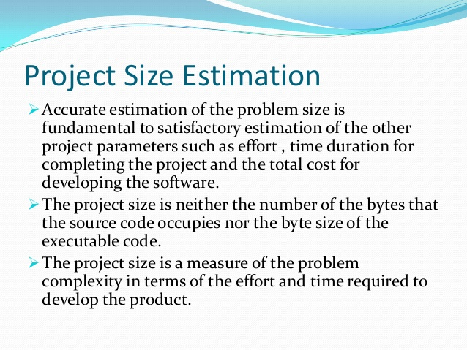
Project size estimation:

Slide 29
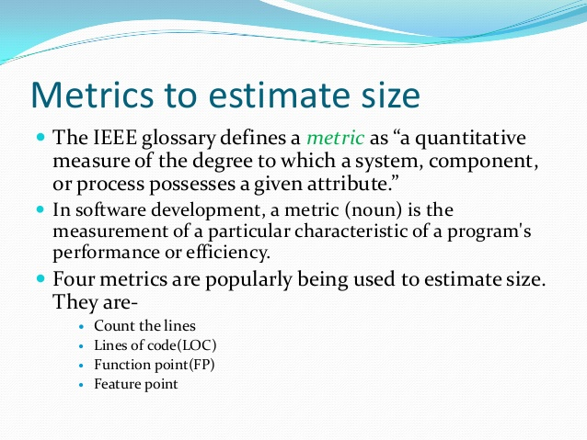

Slide 30
lines of code (LOC):
lines of code (LOC), is a software metric used to measure the size of a computer program by counting the number of lines in the text of the program's source code. SLOC is typically used to predict the amount of effort that will be required to develop a program, as well as to estimate programming productivity or maintainability once the software is produced.

Slide 31
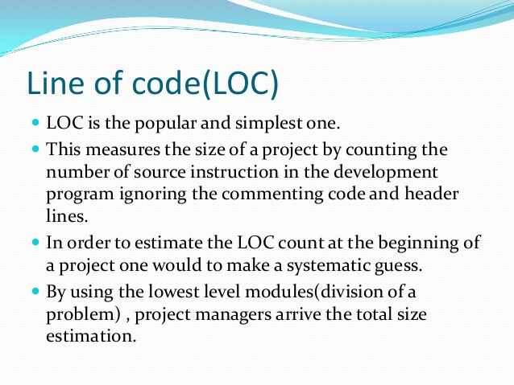
lines of code (LOC) contd:

Slide 32
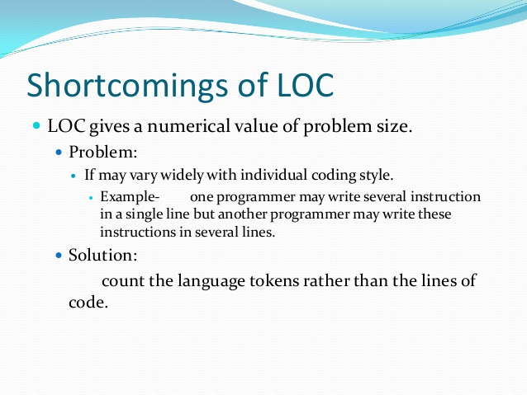

Slide 33
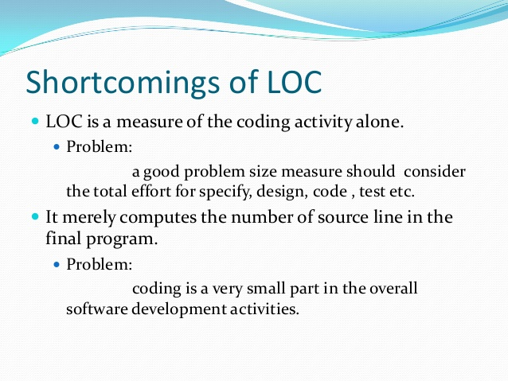

Slide 34
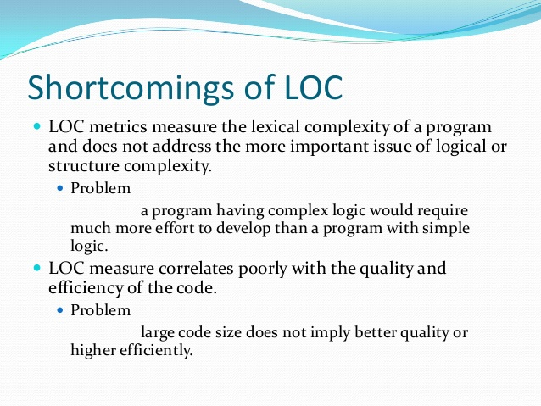

Slide 35
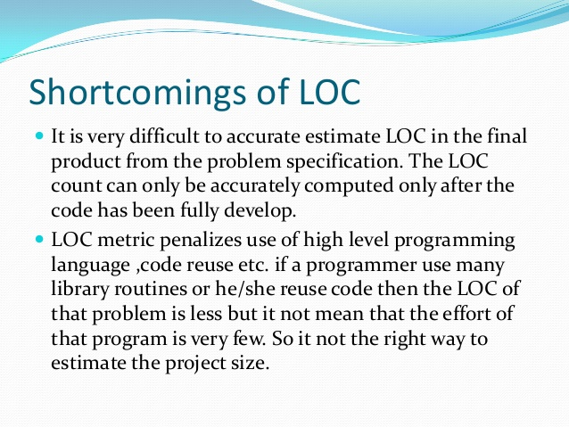

Slide 36
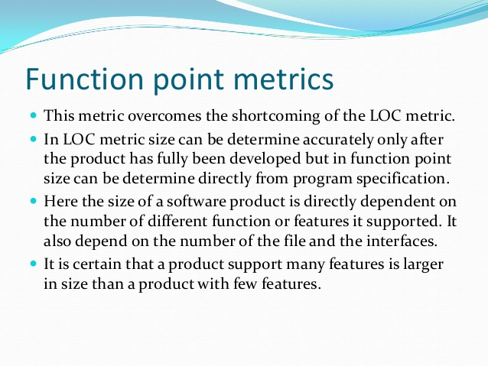

Slide 37
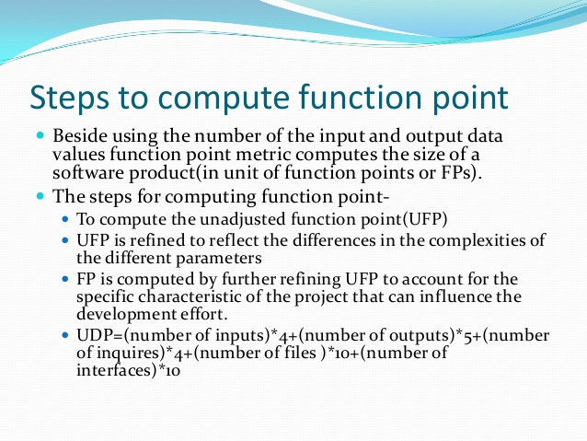

Slide 38
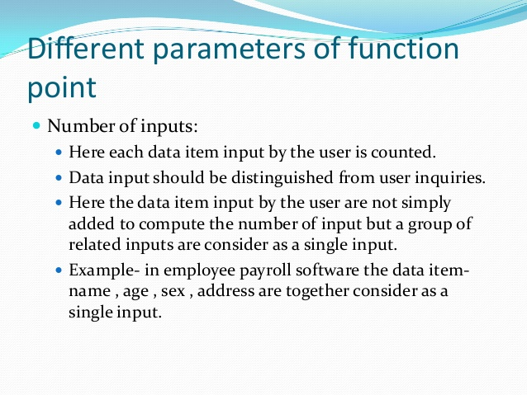

Slide 39
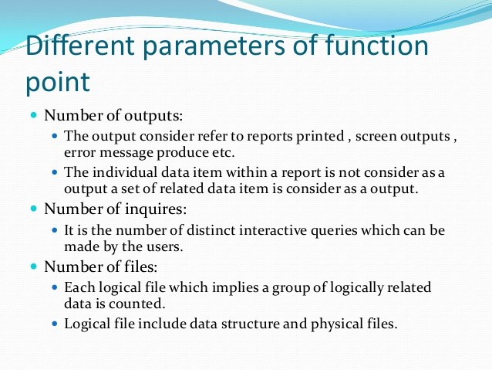

Slide 40
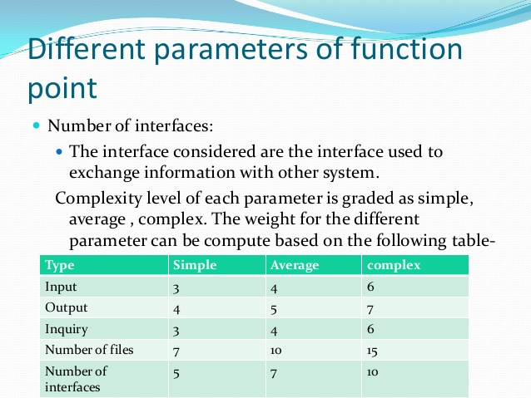

Slide 41
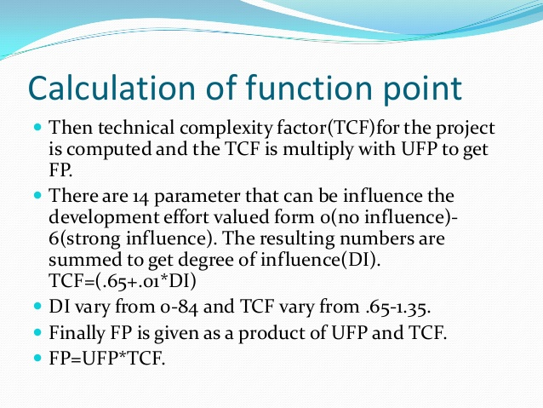

Slide 42
Project estimation technique:
Project estimation techniques are critical survival tools for predicting when a project will finish and how much it will cost. Estimating duration and cost accurately can make the difference between consistent success and frequent failure. Project managers need to use different techniques during the project phases to provide good information to the decision-makers.

Slide 43
Empirical Estimation Techniques
- It is based on making an educated guess of the project parameters. - While using this technique, prior experience with development of similar products is helpful. - Although empirical estimation techniques are based on common sense, different activities involved in estimation have been formalized over the years. - Two popular empirical estimation techniques are: Expert judgement technique and Delphi cost estimation.

Slide 44
Expert Judgment Technique:
Expert Judgment is a term that refers a specifically to a technique in which judgment is made based upon a specific set of criteria and/or expertise that has been acquired in a specific knowledge area, or product area, a particular discipline, an industry, etc. This knowledge base can be provided by a member of the project team, or multiple members of the project team, or by a team leader or team leaders. However, typically expert judgment requires an expertise that is not present within the project team and, as such, it is common for an external group or person with a specific relevant skill set or knowledge base to be brought in for a consultation, Some examples of resources of expert knowledge can be stakeholders, customers, professional and technical organizations, and other miscellaneous industry groups that may provide these types of services for a small fee, or may provider them free of charge (in some cases, only free if one of the members of the project team is a dues paying member of said organization).

Slide 45
The Delphi cost estimation technique:
The Delphi technique was developed at the RAND corporation in 1948 to gain the RAND corporation in 1948 to gain expert consensus without introducing the expert consensus without introducing the adverse side effects of group meetings.

Slide 46
The Delphi technique can be adapted to software cost estimation in the following manner:
A coordinator provides each estimator with the System Definition document and form for recording a cost estimate.
Estimators study the definition and complete their estimates anonymously. They may ask questions of the coordinator, but they do not discuss their estimates with one another.
The coordinator prepares and distributes a summary of the estimators’ responses, and includes any unusual the estimators’ responses, and includes any unusual rationales noted by the estimators.
Estimators complete another estimate again anonymously using the results from the previous anonymously using the results from the previous estimate. Estimators whose estimates differ sharply from the group may be asked, to provide justification from the group may be asked, to provide justification for their estimates.

Slide 47
The process is iterated for as many rounds as required. No group discussion is allowed during the entire process.
The following approach is a variation on the standard Delphi technique that increases communication while preserving anonymity.
The coordinator prepares a summary of the estimates but does not record any rationales. but does not record any rationales.
The coordinator calls a group meeting to focus on issues where the estimates vary widely.
Estimators complete another estimate again anonymously. The process is iterated as many rounds as necessary.

Slide 48
It is possible that several rounds of estimates will not lead to a consensus estimate.
In this case the coordinator must discuss the issues involved with each estimator to determine the reasons for the differences.
The coordinator may have to gather additional information and present it to the estimators in order to resolve the differences.

Slide 49
Heuristic technique:
Heuristic methods are those experience-based software engineering methods that have been and are fairly widely practiced in the software industry. This topic area contains three broad discussion categories: structured analysis and design methods, data modeling methods, and objectoriented analysis and design methods.
Structured Analysis and Design Methods: The software model is developed primarily from a functional or behavioral viewpoint, starting from a high-level view of the software (including data and control elements) and then progressively decomposing or refining the model components through increasingly detailed designs. The detailed design eventually converges to very specific details or specifications of the software that must be coded (by hand, automatically generated, or both), built, tested, and verified.

Slide 50
Data Modeling Methods: The data model is constructed from the viewpoint of the data or information used. Data tables and relationships
define the data models. This data modeling method is used primarily for defining and analyzing data requirements supporting database designs or data repositories typically found in business software, where data is actively managed as a business systems resource or asset.
Object-Oriented Analysis and Design Methods: The object-oriented model is represented as a collection of objects that encapsulate
data and relationships and interact with other objects through methods. Objects may be real-world items or virtual items. The software model is constructed using diagrams to constitute selected views of the software. Progressive refinement of the software models leads to a detailed design. The detailed design is then either evolved through successive iteration or transformed (using some mechanism) into the implementation view of the model, where the code and packaging approach for eventual software product release and deployment is expressed.

Slide 51
The Constructive Cost Model (COCOMO)cost estimation techniquea
The Constructive Cost Model (COCOMO) is an algorithmic software cost estimation model developed by Barry Boehm. The model uses a basic regression formula, with parameters that are derived from historical project data and current project characteristics.

Slide 52
COCOMO was first published in 1981 Barry W. Boehm's Book Software engineering economics[1] as a model for estimating effort, cost, and schedule for software projects. It drew on a study of 63 projects at TRW Aerospace where Barry Boehm was Director of Software Research and Technology in 1981. The study examined projects ranging in size from 2,000 to 100,000 lines of code, and programming languages ranging from assembly to PL/I. These projects were based on the waterfall model of software development which was the prevalent software development process in 1981.

Slide 53
References to this model typically call it COCOMO 81. In 1997 COCOMO II was developed and finally published in 2000 in the book Software Cost Estimation with COCOMO II[2]. COCOMO II is the successor of COCOMO 81 and is better suited for estimating modern software development projects. It provides more support for modern software development processes and an updated project database. The need for the new model came as software development technology moved from mainframe and overnight batch processing to desktop development, code reusability and the use of off-the-shelf software components. This article refers to COCOMO 81.

Slide 54
COCOMO consists of a hierarchy of three increasingly detailed and accurate forms. The first level, Basic COCOMO is good for quick, early, rough order of magnitude estimates of software costs, but its accuracy is limited due to its lack of factors to account for difference in project attributes (Cost Drivers). Intermediate COCOMO takes these Cost Drivers into account and Detailed COCOMO additionally accounts for the influence of individual project phases. Basic COCOMO computes software development effort (and cost) as a function of program size. Program size is expressed in estimated thousands of lines of code (KLOC).

Slide 55
COCOMO applies to three classes of software projects:
* Organic projects - "small" teams with "good" experience working with "less than rigid" requirements
* Semi-detached projects - "medium" teams with mixed experience working with a mix of rigid and less than rigid requirements
* Embedded projects - developed within a set of "tight" constraints (hardware, software, operational, ...)

Slide 56
The basic COCOMO equations take the form
Effort Applied = ab(KLOC)bb [ man-months ]
Development Time = cb(Effort Applied)db [months]
People required = Effort Applied / Development Time [count]

Slide 57
Basic COCOMO is good for quick estimate of software costs. However it does not account for differences in hardware constraints, personnel quality and experience, use of modern tools and techniques, and so on.
Intermediate COCOMO computes software development effort as function of program size and a set of "cost drivers" that include subjective assessment of product, hardware, personnel and project attributes. This extension considers a set of four "cost drivers",each with a number of subsidiary attributes:-

Slide 58
Product attributes
Required software reliability
Size of application database
Complexity of the product
* Hardware attributes
Run-time performance constraints
Memory constraints
Volatility of the virtual machine environment
Required turnabout time
* Personnel attributes
Analyst capability
Software engineering capability
Applications experience
Virtual machine experience
Programming language experience
* Project attributes
Use of software tools
Application of software engineering methods
Required development schedule

Slide 59
Analytical Estimation Techniques
Analytical estimation techniques derive the required results starting with basic assumptions regarding the project. Thus, unlike empirical and heuristic techniques, analytical techniques do have scientific basis. Halstead’s software science is an example of an analytical technique. Halstead’s software science can be used to derive some interesting results starting with a few simple assumptions. Halstead’s software science is especially useful for estimating software maintenance efforts. In fact, it outperforms both empirical and heuristic techniques when used for predicting software maintenance efforts.

Slide 60
Project Scheduling
Project scheduling is concerned with the techniques that can be employed to manage the activities that need to be undertaken during the development of a project.
Scheduling is carried out in advance of the project commencing and involves:
identifying the tasks that need to be carried out;
estimating how long they will take;
allocating resources (mainly personnel);
scheduling when the tasks will occur.

Slide 61
Once the project is underway control needs to be exerted to ensure that the plan continues to represent the best prediction of what will occur in the future:
based on what occurs during the development;
often necessitates revision of the plan.
Effective project planning will help to ensure that the systems are delivered:
• within cost;
• within the time constraint;
• to a specific standard of quality.

Slide 62
Two project scheduling techniques will be presented, the Milestone Chart (or Gantt Chart) and the Activity Network.
Gantt Charts
A Gantt chart is a horizontal bar or line chart which will commonly include the following features:
• activities identified on the left hand side;
• time scale is drawn on the top (or bottom) of the chart;
• a horizontal open oblong or a line is drawn against each activity indicating estimated duration;
• dependencies between activities are shown;
• at a review point the oblongs are shaded to represent the actual time spent (an alternative is to represent actual and estimated by 2 separate lines);
• a vertical cursor (such as a transparent ruler) placed at the review point makes it possible to establish activities which are behind or ahead of schedule.

Slide 63
Organization structure
Usually every software development organization handles several projects at any time. Software organizations assign different teams of engineers to handle different software projects. Each type of organization structure has its own advantages and disadvantages so the issue “how is the organization as a whole structured?” must be taken into consideration so that each software project can be finished before its deadline.

Slide 64
Functional format vs. project format
There are essentially two broad ways in which a software development organization can be structured: functional format and project format. In the project format, the project development staff are divided based on the project for which they work (as shown in fig. 12.1). In the functional format, the development staff are divided based on the functional group to which they belong. The different projects borrow engineers from the required functional groups for specific phases to be undertaken in the project and return them to the functional group upon the completion of the phase.

Slide 65
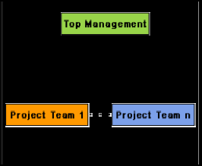
Fig. Project organization

Slide 66
In the functional format, different teams of programmers perform different phases of a project. For example, one team might do the requirements specification, another do the design, and so on. The partially completed product passes from one team to another as the project evolves. Therefore, the functional format requires considerable communication among the different teams because the work of one team must be clearly understood by the subsequent teams working on the project. This requires good quality documentation to be produced after every activity.
In the project format, a set of engineers is assigned to the project at the start of the project and they remain with the project till the completion of the project. Thus, the same team carries out all the life cycle activities. Obviously, the functional format requires more communication among teams than the project format, because one team must understand the work done by the previous teams.

Slide 67
Team structures
Team structure addresses the issue of organization of the individual project teams. There are some possible ways in which the individual project teams can be organized. There are mainly three formal team structures: chief programmer, democratic, and the mixed team organizations although several other variations to these structures are possible. Problems of different complexities and sizes often require different team structures for chief solution.

Slide 68
Chief Programmer Team
In this team organization, a senior engineer provides the technical leadership and is designated as the chief programmer. The chief programmer partitions the task into small activities and assigns them to the team members. He also verifies and integrates the products developed by different team members. The structure of the chief programmer team is shown in fig. 12.2. The chief programmer provides an authority, and this structure is arguably more efficient than the democratic team for well-understood problems. However, the chief programmer team leads to lower team morale, since team-members work under the constant supervision of the chief programmer. This also inhibits their original thinking. The chief programmer team is subject to single point failure since too much responsibility and authority is assigned to the chief programmer.

Slide 69
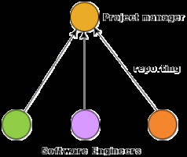
Fig. : Chief programmer team structure

Slide 70
Risk In Software Engineering
Very simply, a risk is a potential problem. It’s an activity or event that may compromise the success of a software development project. Risk is the possibility of suffering loss, and total risk exposure to a specific project will account for both the probability and the size of the potential loss.
Guesswork and crisis-management are never effective. Identifying and aggregating risks is the only predictive method for capturing the probability that a software development project will experience unplanned or inadmissible events. These include terminations, discontinuities, schedule delays, cost underestimation, and overrun of project resources

Slide 71
Risk Management In Software Engineering
Risk management means risk containment and mitigation. First, you’ve got to identify and plan. Then be ready to act when a risk arises, drawing upon the experience and knowledge of the entire team to minimize the impact to the project. Risk management includes the following tasks:
Identify risks and their triggers
Classify and prioritize all risks
Craft a plan that links each risk to a mitigation
Monitor for risk triggers during the project
Implement the mitigating action if any risk materializes
Communicate risk status throughout project

Slide 72
Identify and Classify Risks
Most software engineering projects are inherently risky because of the variety potential problems that might arise. Experience from other software engineering projects can help managers classify risk. The importance here is not the elegance or range of classification, but rather to precisely identify and describe all of the real threats to project success. A simple but effective classification scheme is to arrange risks according to the areas of impact.

Slide 73
Five Types of Risk In Software Project Management
New, unproven technologies
User and functional requirements
Application and system architecture
Performance
Organizational

Slide 74
New, unproven technologies:
The majority of software projects entail the use of new technologies. Ever-changing tools, techniques, protocols, standards, and development systems increase the probability that technology risks will arise in virtually any substantial software engineering effort. Training and knowledge are of critical importance, and the improper use of new technology most often leads directly to project failure.

Slide 75
User and functional requirements.
Software requirements capture all user needs with respect to the software system features, functions, and quality of service. Too often, the process of requirements definition is lengthy, tedious, and complex. Moreover, requirements usually change with discovery, prototyping, and integration activities. Change in elemental requirements will likely propagate throughout the entire project, and modifications to user requirements might not translate to functional requirements. These disruptions often lead to one or more critical failures of a poorly-planned software development project.

Slide 76
Application and system architecture
Taking the wrong direction with a platform, component, or architecture can have disastrous consequences. As with the technological risks, it is vital that the team includes experts who understand the architecture and have the capability to make sound design choices.

Slide 77
Performance
It’s important to ensure that any risk management plan encompasses user and partner expectations on performance. Consideration must be given to benchmarks and threshold testing throughout the project to ensure that the work products are moving in the right direction.

Slide 78
Organizational:
Organizational problems may have adverse effects on project outcomes. Project management must plan for efficient execution of the project, and find a balance between the needs of the development team and the expectations of the customers. Of course, adequate staffing includes choosing team members with skill sets that are a good match with the project.

Slide 79
risk assessment
Software risk assessment is a process of identifying, analyzing, and prioritizing risks. In general, there are large, medium, and small software projects that each of them can be influenced by a risk. Therefore, it needs a unique assessment process of the possible risks that may cause failure or loss of the project if they occur. In the literature, there are wide range of risk assessment researches conducted toward software projects. But there is at least view researches focusing on risk assessment of small and medium software projects. This creates a gap for the risk assessment research field which can cause most of small and medium project without having risk assessment. Therefore, the main focus of the paper is to give researchers an insight of the current level of risk assessment for small and medium software development projects. Finally, some future directions will be discussed hoping to insight the gap of the risk assessment field for small and medium software development projects.

Slide 80
Risk containment
In many cases during the risk assessment process, the project manager and the team will be able to identify strategies to minimize or eliminate the risk factors. For example, if the team is perceived to be a high risk because of lack of experience in the development platform, the recruiting of experts or hiring expert contractors can control the risk. All high risk factors that cannot be constrained or eliminated during the risk assessment sessions should have a risk memorandum developed for them, documenting the risk, the impact of the risk on the project, what actions the steering committee and project sponsor can take to assist in reducing the risk, and, for high-impact risks, a contingency plan.

Slide 81
Software configuration Management:
Software Configuration Management is an ability to control and manage change in a software project. Changes are inherent and ongoing in any software project. The ability to track control such changes in a proper manner form a good software project. Software Configuration Management tries to bridge this gap by defining a process for the change control.

Slide 82
Necessity of Software configuration Management:
The need for an SCM process came when there are many developers and many versions of the software. Suffice to say that in a complex scenario where bug fixing should happen on multiple productions of systems and enhancements must be continued on the main code base, SCM acts as the backbone which can make this happen.
The SCM processes further defines the need to trace the changes and the ability to verify that the final delivered software has all the planned enhancements that are supposed to be part of the release.

Slide 83
The SCM identifies some procedures that must be defined for each software project to ensure that a good SCM process is implemented. Those are following:
Identification
Control
Status Accounting/Monitoring
Authentication

Slide 84
Identification
Software is usually made up of several programs. Each program has it’s related documentation and data can be called as a “configurable item”(CI). The number of CI in any software project that make up a CI is a decision made of the project. The end product is made up of a bunches of CIs.

Slide 85
Control
The process of deciding, coordinating the approved changes for the proposed CIs and implementing all the changes on the appropriate baseline is called Configuration control. It should be kept in mind that configuration controls only address the process after changes are approved. The act of evaluating and approving changes to the software comes under the purview of an entirely different process is called change control.

Slide 86
Status Accounting/Monitoring
Configuration status accounting is the keeping process of each release. This procedure involves tracking what all is in each version of software and the changes that lead to this version. Configuration status accounting keeps a record of all the changes made to the previous baseline to reach of the new baseline.

Slide 87
Authentication
Configuration authentication (CA) is a process of assuring that a new baseline has all the planned and approved changes incorporated. The process involves verifying that all the functional aspects of the software is completed and also the completeness of the delivery in terms of the right programs, documentation and data are being delivered.

Slide 88
Revision Control System (RCS)
Revision Control System (RCS) is an early version control system (VCS). It can be thought of as a set of UNIX commands that allow multiple users to develop and maintain program code or documents. With RCS, users can make their own revisions of a document, commit changes, and merge them together. RCS was originally developed for programs but is also useful for text documents or configuration files that are frequently revised.

Slide 89
Mode of operation of RCS
RCS operates only on single files. It has no way of working with an entire project, so it does not support atomic commits affecting multiple files. Although it provides branching for individual files, the version syntax is cumbersome. Instead of using branches, many teams just use the built-in locking mechanism and work on a single head branch.

Slide 90
Usage of RCS:
RCS revolves around the usage of "revision groups" or sets of files that have been checked-in via the "co" (checkout) and "ci" (check-in) commands. By default, a checked-in file is removed and replaced with a ",v" file (so foo.rb when checked in becomes foo.rb,v) which can then be checked out by anyone with access to the revision group. RCS files (again, files with the extension ",v") reflect the main file with addition metadata on its first lines. Once checked in, RCS stores revisions in a tree structure that can be followed so that a user can revert a file to a previous form if necessary.

Slide 91
Advantages of RCS:
Simple structure and easy to work with
Revision saving is not dependent on a central repository

Slide 92
Disadvantages of RCS:
There is little security, in the sense that the version history can be edited by the users.
Only one user can work on a file at a time.

Slide 93
Source Code Control System (SCCS) mean?
Source Code Control System (SCCS) is a specific kind of revision control resource that’s aimed at changing source code in manageable ways. This program was developed in the 1970s for IBM systems and was later adapted for UNIX.
Source Code Control System was popular until it was largely replaced by newer kinds of revision control resources. Experts point out that SCCS played a role in fixing year 2000 problems around the handling of the millennial change in various computer systems.

Slide 94
Elements of Source Code Control System are still seen in today’s revision control tools. One thing that this software is known for is an "sccsid" variable, which consists of a file name, date and a potential comment. This customized variable could be used to note various changes or versions of a software program or source code module.

